Slide 1
Forward Kinematics.
Design Problem 1

Slide 2
Agenda
Problem Background
Learning Objectives
Coding

Slide 3
Background
The use of the kinematic equations to compute the position of the end of the arm using specified values for the joint parameters.
Forward kinematics is used heavily in robotics, computer games, and animation.
Example: The Canada Arm

Slide 4
Another cool example

Slide 5
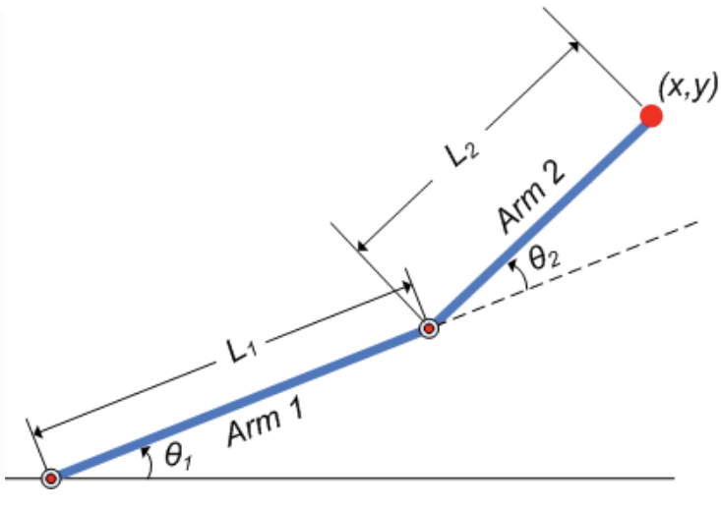
Background
Will rely on trigonometry to find the positions.
Goal: Create a program that will find the x- and y- position of the effector arm (i.e. the end of Arm #2).

Slide 6
Learning Objectives
Practice with user input.
Learn to define and use custom functions.
Practice with built-in libraries.
Optional: Add some cool visualization ☺

Slide 7
Engineering Design Process
Learn to define the problem.
Practice defining test cases.
Develop an algorithm plan (i.e. a workflow!).
Program your solution and debugging.

Slide 8
Some reminders.

Slide 9
Function Definitions
Definition
Function Name
Colon
def function_body(parameters):
body
Indent
(parameter1,
parameter2, …)
What is in the body?

Slide 10
Function Definitions
def function_body(parameters):
1. “““DOCSTRING””” (optional)
2. Code that does the thing
3. return [expression]
The return statement is optional and if it is not included, it’s the same as writing return None

Slide 11
Calling Functions
In Python names of variables and functions use low case and underscores.
function_name
Function_Name
FunctionName
The general form of a function call:
Terminology
argument: a value given to a function.
pass: to provide an argument to a function.
call: ask Python to execute a function (by name).
return: give a value back to where the function was called from.
function_name(arguments)

Slide 12
Input
Python has a built-in function named input for reading text from the user.
The general form of a input function call:
The argument is the text you want displayed to the user.
“What is your name?”
The value returned by the input function is always a string.
input(argument)

Slide 13
Importing Functions and Modules
The general for of an import statement is:
import module_name
To access a function within a module:
module_name.function_name

Slide 14
Forward Kinematics.
Design Problem 1

